Slide 1

smart METAL Detector
By
E SAI PRKASH GOUD
G SAI GOUTHAM
GATLA SAI SHIVA REDDY
GHANTASALA MANASA

Slide 2
TABLE OF CONTENTS
INTRODUCTION
PRINCIPLE OF OPERATION
METAL DETECTORS :how, why and when
SENSORS NEEDED
CIRCUIT DIAGRAM
ADVANTAGES AND DISADVANTAGES
APPLICATION
CONCLUSION

Slide 3
INTRODUCTION
Metal detector is a device that can detect metal, the basics can make a sound when it is near some metal.
In 1881, Alexander Graham Bell invented the first metal detector. As President James Garfield lay dying of an assassin's bullet, Bell hurriedly invented a crude metal detector in an unsuccessful attempt to locate the fatal slug. Bell's metal detector was an electromagnetic device he called the induction balance. The need for detection is very clear to protect our self from any kind of danger.
In 1925, Gerhard Fischar invented a portable metal detector. Fischar's model was first sold commercially in 1931 and Fischar was behind the first large-scale production of metal detectors.

Slide 4
NEED FOR METAL DETECTORS
The metal detector should always work in an accurate & precise manner. These find wide usage in many industrial processes. They are tremendously used in important sites like airport, railways, hotels, military facility, and various other government buildings for providing security. They are usually used in detecting weapons, gold or any other metal at these sites. They also find applications in civil engineering. It is widely used in archaeology to search the remains of the extinct species and relics.

Slide 5
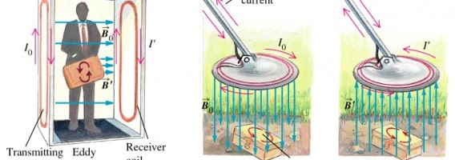
PRINCIPLE OF OPERATION
The operation of metal detectors is based upon the principles of electromagnetic induction.
Metal detectors contain one or more inductor coils that are used to interact with metallic elements on the ground.
The single-coil detector illustrated below is a simplified version of one used in a real metal detector.
A pulsing current is applied the coil, which then induces a magnetic field. When the magnetic field of the coil moves across the coil, the field induces an electric current(called eddy currents) in the metal. The eddy currents induce their own magnetic field , which generates an opposite an opposite current in the coil, which induces a signal indicating the presence of metal.

Slide 6
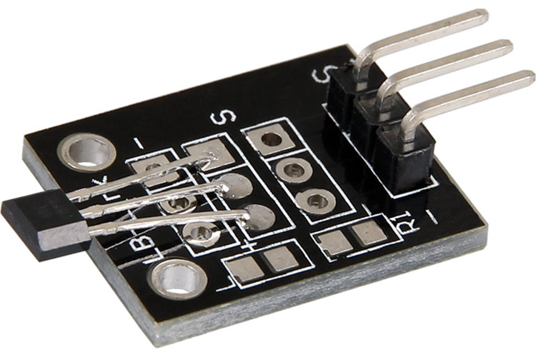
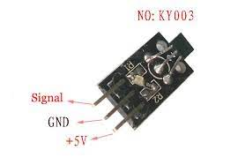
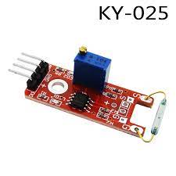
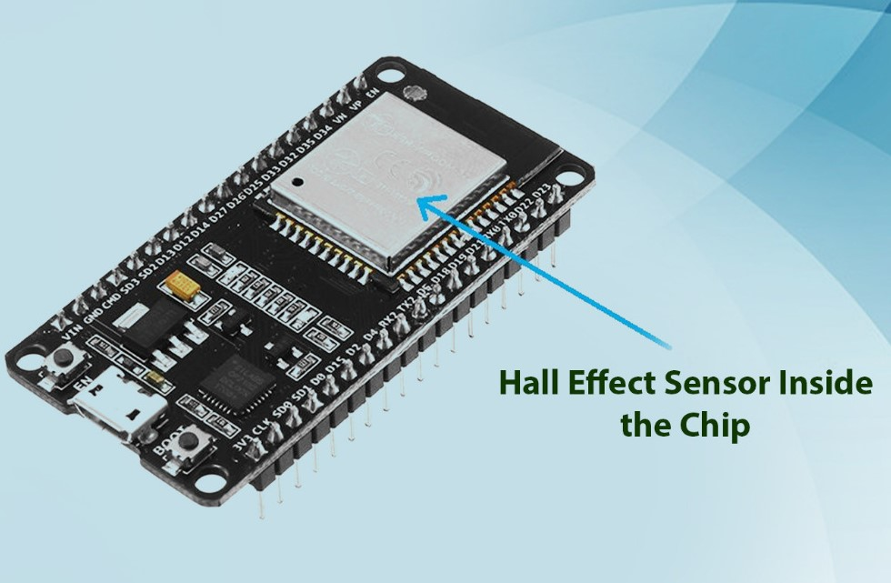
SENSORS
KY-024 LINEAR HALL MAGNETIC SENSOR
KY-035 ANALOG HALL SENSOR
KY-003 HALL MAGNETIC SENSOR
KY-025 REED SWITCH
INBUILT HALL SENSOR ESP32

Slide 7
HALL effect sensors
The hall effect sensor is a type of magnetic sensor which can be used for detecting the strength and direction of a magnetic field produced from a permanent magnet or an electromagnet with its output varying in proportion to the strength of the magnetic field being detected.
Hall Effect Sensors are devices which are activated by an external magnetic field. We know that a magnetic field has two important characteristics flux density, (B) and polarity (North and South Poles).
The output signal from a Hall effect sensor is the function of magnetic field density around the device. When the magnetic flux density around the sensor exceeds a certain pre-set threshold, the sensor detects it and generates an output voltage called the Hall Voltage, V_{H}.

Slide 8
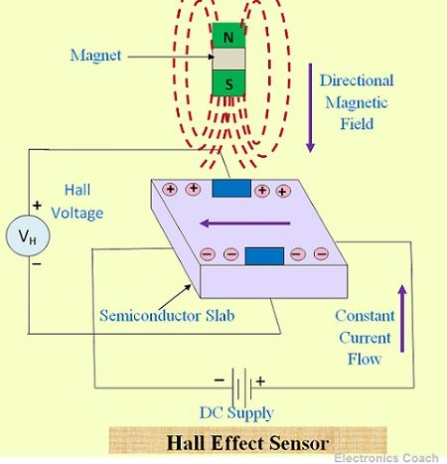
HALL EFFECT SENSOR PRINCIPLE
Hall Effect Sensors consist basically of a thin piece of rectangular p-type semiconductor material such as gallium arsenide (GaAs), indium antimonide (InSb) or indium arsenide (InAs) passing a continuous current through itself.When the device is placed within a magnetic field, the magnetic flux lines exert a force on the semiconductor material which deflects the charge carriers, electrons and holes, to either side of the semiconductor slab. This movement of charge carriers is a result of the magnetic force they experience passing through the semiconductor material.
As these electrons and holes move side wards a potential difference is produced between the two sides of the semiconductor material by the build-up of these charge carriers. Then the movement of electrons through the semiconductor material is affected by the presence of an external magnetic field which is at right angles to it and this effect is greater in a flat rectangular shaped material. The effect of generating a measurable voltage by using a magnetic field is called the Hall Effect.

Slide 9
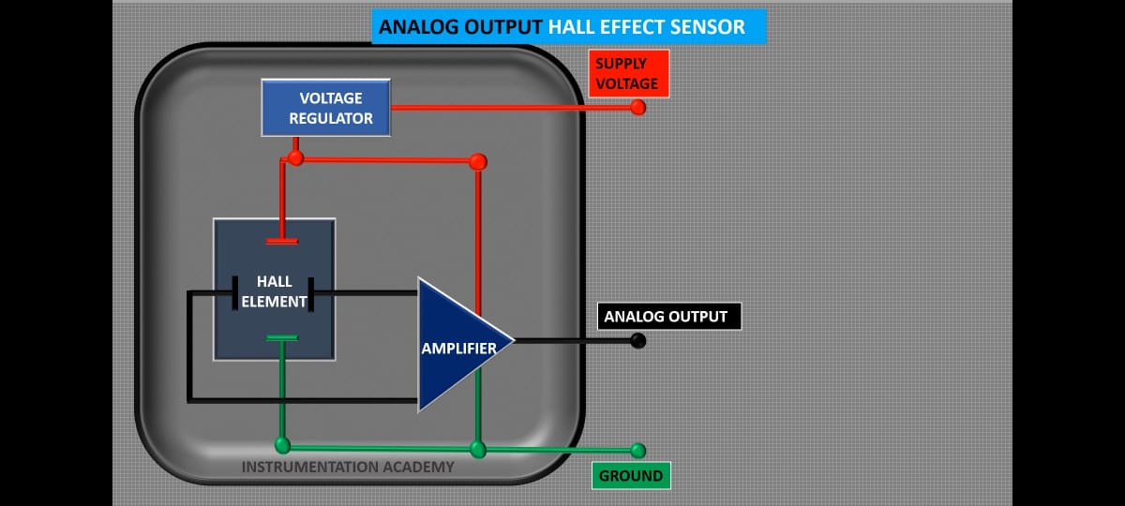
ANALOG HALL SENSOR
It is important to detect and measure magnetic field of any component in many industrial applications. If you want to detect if the magnetic tip of the tool is still magnetized or if electromagnet you designed to separate magnetic objects from heap of scrap the test of magnetic field is a must and electromagnets are quite big in size so we need a sensor which is small and portable to be used everywhere in need. The KY-035 Hall Effect Magnetic Sensor Module is an analog sensor which reads the strength of magnetic field and outputs the corresponding voltage at the analog output pin. It is a 5V sensor and it can be used with Microcontrollers and development boards like ESP32,Arduino, Raspberry Pi, ARM and PIC etc.

Slide 10
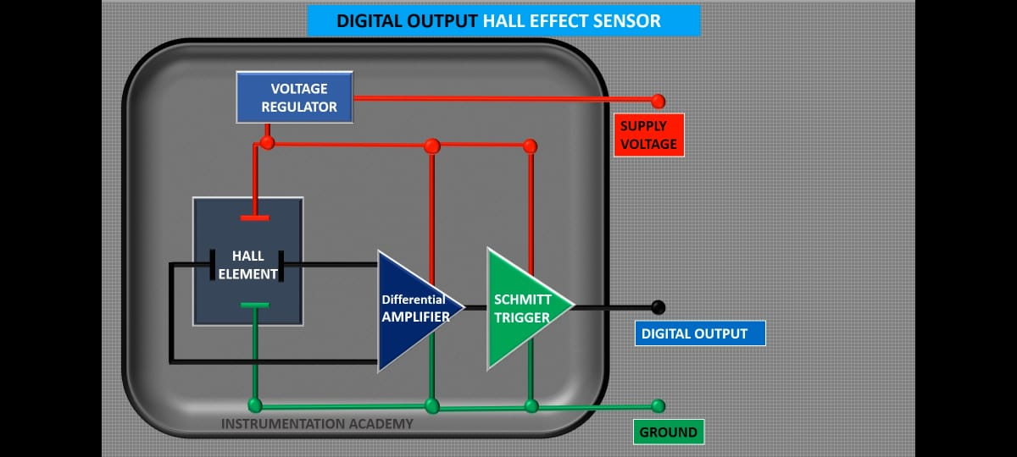
MAGNETIC HALL SENSOR
The hall effect sensor is just like switch as it works on hall effect principle so, it is more sensitive to magnetic flux and suitable for harsh environment because of semiconductor type casing and no glass encapsulation. This Ky003 Hall Effect/Magnetic Sensor module has 3144EUA-S hall effect sensor, it changes its state if one pole of magnet comes near it which can be easily read by any Digital GPIO pin on the Microcontroller board. This is ideal for commercial, consumer and industrial applications like measuring the RPM of the wheel, position sensor for machining tools, positional feedback for control systems, detecting the poles of magnets in BLDC Motors, magnetic alarm doors etc.

Slide 11
LINEAR HALL EFFECT SENSOR
KY-024 Linear Magnetic Hall Effect Sensor is a small, versatile, linear unipolar hall-effect sensor board that can act as a magnetic switch or simply measuring the strength of the magnetic field present. This hall effect sensor module works on hall effect principle so, it is more sensitive to magnetic flux and suitable for harsh environment because of semiconductor type casing and no glass encapsulation. This can work as both analog and digital unipolar hall effect sensor, it changes its state if one pole of magnet comes near it which can be easily read by any Digital GPIO pin on the Microcontroller board like Arduino, Raspberry Pi, Beagle bone Black, if is working in Digital Mode or you can connect the Analog output to any ADC and see the strength of the magnetic field present.
This is ideal for commercial, consumer and industrial applications like measuring the RPM of the wheel, position sensor for machining tools, positional feedback for control systems, detecting the poles of magnets in BLDC Motors, magnetic alarm doors etc. There is a 49E Linear Hall-Effect Sensor, a LM393 Dual Differential Comparator, a potentiometer, two LED's, and six resistors in KY-024 module. With the help of potentiometer, you can change the sensitivity of the module to provide digital output.

